Slide 1
Climate change indicators- india
k.Nitheesh kumar
S20150010030 - cse

Slide 2
INTRODUCTION
Climate Change :
A change in global or regional climate patterns, in particular a change apparent from the mid to late 20th century onwards and attributed largely to the increased levels of atmospheric carbon dioxide produced by the use of fossil fuels.
Global Temperature rise, Warming oceans, Shrinking ice sheets, Glacial retreat, Decreased snow cover, Sea level rise, Ocean acidification are some indicators of Climate Change.

Slide 3
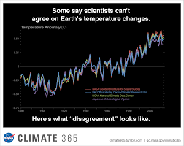
Evidence for climate change:

Slide 4
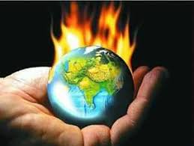
Global Temperature Rise
The planet's average surface temperature has risen about 1.62 degrees Fahrenheit (0.9 degrees Celsius) since the late 19th century, a change driven largely by increased carbon dioxide and other human-made emissions into the atmosphere.4 Most of the warming occurred in the past 35 years, with the five warmest years on record taking place since 2010. Not only was 2016 the warmest year on record, but eight of the 12 months that make up the year — from January through september, with the exception of June — were the warmest on record for those respective months.

Slide 5

Warming seas
The oceans have absorbed much of this increased heat, with the top 700 meters (about 2,300 feet) of ocean showing warming of more than 0.4 degrees Fahrenheit since 1969.

Slide 6
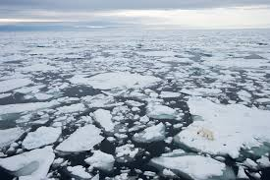
Shrinking ice sheets
The Greenland and Antarctic ice sheets have decreased in mass. Data from NASA's Gravity Recovery and Climate Experiment show Greenland lost an average of 281 billion tons of ice per year between 1993 and 2016, while Antarctica lost about 119 billion tons during the same time period. The rate of Antarctica ice mass loss has tripled in the last decade.

Slide 7
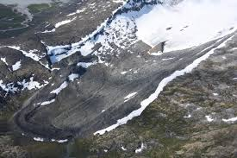
Glacial retreat
Glaciers are retreating almost everywhere around the world — including in the Alps, Himalayas, Andes, Rockies, Alaska and Africa.

Slide 8
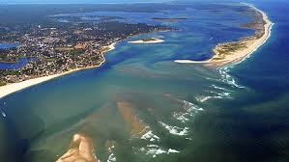
Sea level rise
Global sea level rose about 8 inches in the last century. The rate in the last two decades, however, is nearly double that of the last century and is accelerating slightly every year.

Slide 9
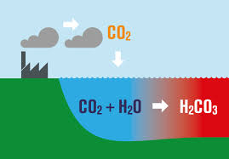
Ocean Acidification
Since the beginning of the Industrial Revolution, the acidity of surface ocean waters has increased by about 30 percent.13,14 This increase is the result of humans emitting more carbon dioxide into the atmosphere and hence more being absorbed into the oceans. The amount of carbon dioxide absorbed by the upper layer of the oceans is increasing by about 2 billion tons per year.

Slide 10
Green house gases
Life on Earth depends on energy coming from the sun. About half the light reaching Earth's atmosphere passes through the air and clouds to the surface, where it is absorbed and then radiated upward in the form of infrared heat. About 90 percent of this heat is then absorbed by the greenhouse gases and radiated back toward the surface, which is warmed to a life-supporting average of 59 degrees Fahrenheit (15 degrees Celsius).

Slide 11
Effects of climate change

Slide 12
Effects of climate change
Temperatures will continue to rise
Frost-free season (and growing season) will lengthen
Changes in precipitation patterns
More droughts and heat waves
Hurricanes will become stronger and more intense
Sea level will rise 1-4 feet by 2100
Arctic likely to become ice-free
Human Health

Slide 13
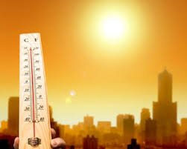
Temperature will continue to rise
Because human-induced warming is superimposed on a naturally varying climate, the temperature rise has not been, and will not be, uniform or smooth across the country or over time.

Slide 14
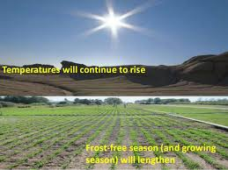
Frost-free season (and growing season) will lengthen
The length of the frost-free season (and the corresponding growing season) has been increasing nationally since the 1980s, with the largest increases occurring in the western United States, affecting ecosystems and agriculture. Across the United States, the growing season is projected to continue to lengthen.

Slide 15
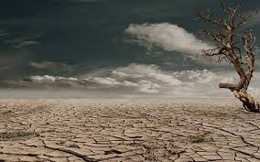
More droughts and heat waves
Droughts in the Southwest and heat waves (periods of abnormally hot weather lasting days to weeks) everywhere are projected to become more intense, and cold waves less intense everywhere.

Slide 16
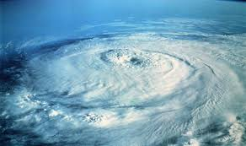
Hurricanes will become stronger and more intense
The intensity, frequency and duration of North Atlantic hurricanes, as well as the frequency of the strongest (Category 4 and 5) hurricanes, have all increased since the early 1980s. The relative contributions of human and natural causes to these increases are still uncertain. Hurricane-associated storm intensity and rainfall rates are projected to increase as the climate continues to warm.

Slide 17
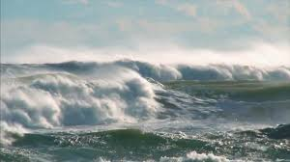
Sea level will rise 1-4 feet by 2100
Global sea level has risen by about 8 inches since reliable record keeping began in 1880. It is projected to rise another 1 to 4 feet by 2100. This is the result of added water from melting land ice and the expansion of seawater as it warms.

Slide 18
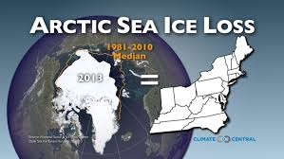
Arctic likely to become ice-free
The Arctic Ocean is expected to become essentially ice free in summer before mid-century.

Slide 19

Human Health Issue
The influences of weather and climate on human health are significant and varied. Exposure to health hazards related to climate change affects different people and different communities to different degrees. While often assessed individually, exposure to multiple climate change threats can occur simultaneously, resulting in compounding or cascading health impacts.

Slide 20
Stopping climate changer and greener living
Climate Change can be slowed down by adpoting to Greener Living which means - A lifestyle that tries in as many ways as it can to bring into balance the conservation and preservation of the Earth's natural resources, habitats, and biodiversity with human culture and communities.
Reducing the usage of fossil fules.
Reduce Fracking.
Use Renewable sources of Energy.
Plant more Trees.
Reduce Meat Consumption.
Reduce Water Usage.

